Slide 1
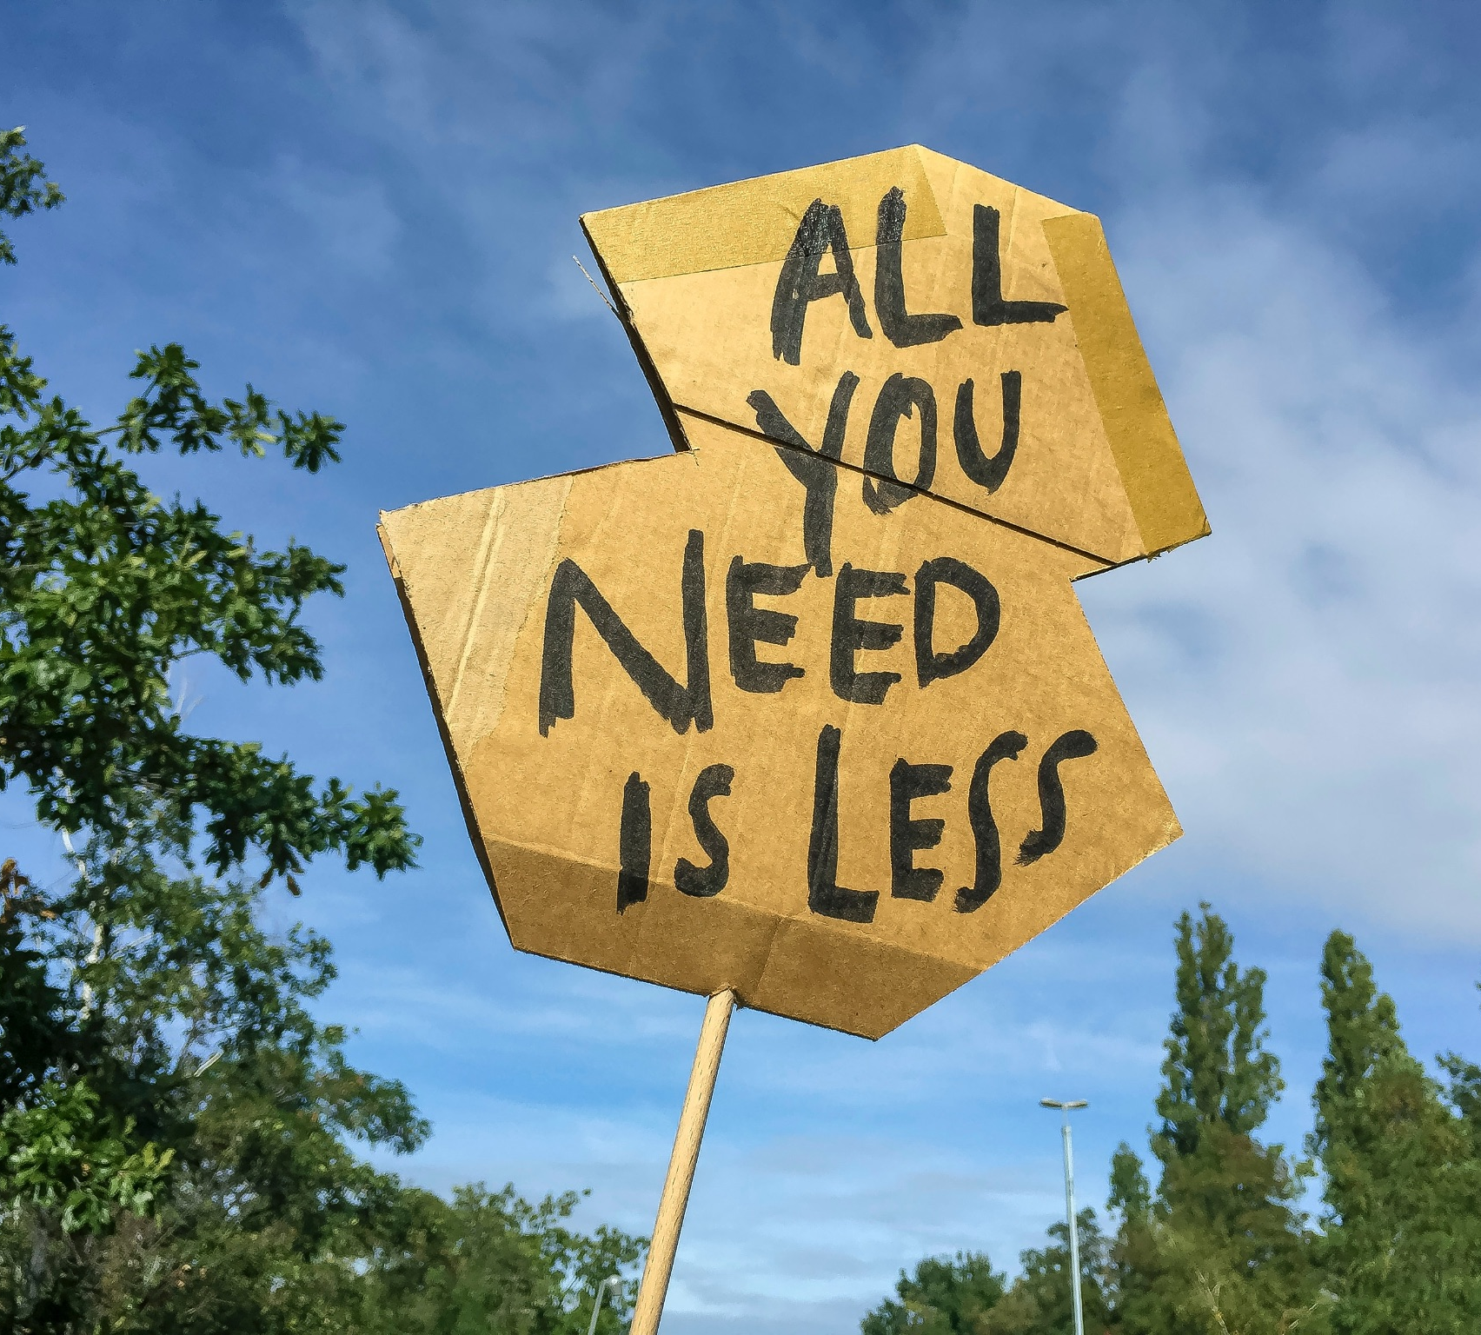
CSCI 455:
Energy
Sustainability
Angily, Nelson, Nickolas & Christine

Slide 2
Table of Contents
01
02
03
Introduction
Scope
Implementation/ Analysis
04
05
Demos
Conclusions
What is Energy Sustainability?
Importance of Carbon Trackers
Our Project
Layout, Functionality & Live Demo
Key Takeaways and Future Plans

Slide 3
Energy Sustainability
Energy sustainability refers to the responsible use of energy resources in a way that meets present needs without compromising future generations. It involves transitioning from non-renewable to renewable sources, promoting energy efficiency, reducing waste, and ensuring affordable and reliable energy access for all.

Slide 4
16.5 Metric Tons
According to the Global Carbon Atlas, the United States is one of the top emitters of carbon dioxide per capita, producing 16.5 metric tons of carbon dioxide per person per year, which is more than twice the global average of 7.55 metric tons per person per year. This highlights the urgent need for the US to reduce its carbon footprint to mitigate the impacts of climate change.

Slide 5
Purpose and Motivation
Motivation:
To bring awareness to carbon footprinting
Purpose:
To help the environment, our app will give advice on how to lower an individual’s carbon emissions and will also track their carbon footprint

Slide 6
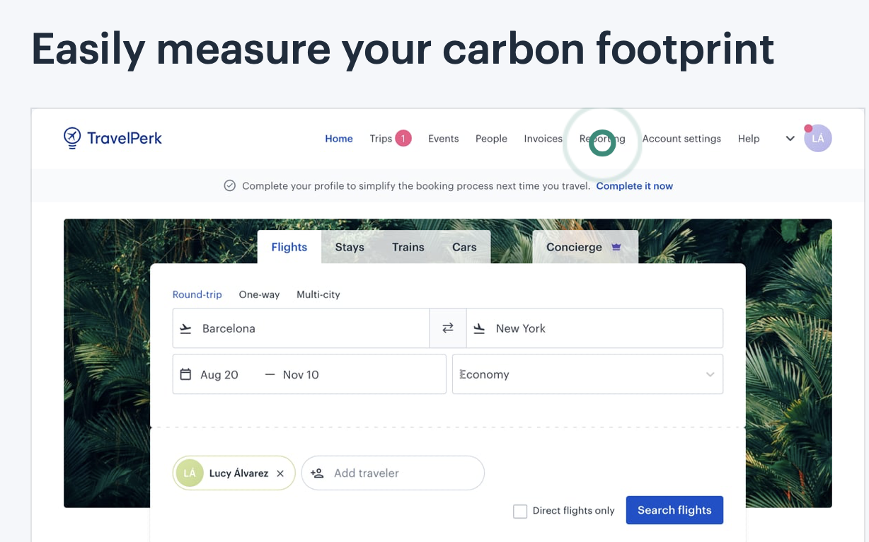
Similar Application
Joro: Focuses on the carbon footprint of everything you buy
Klima: Gives suggestions for food, transportation, and lifestyle changes that will reduce your carbon footprint
Adva:Provides users with advice on changes for a more eco-living lifestyle
Capture: Allows individuals or businesses to analyze the emissions from their daily lifestyles

Slide 7
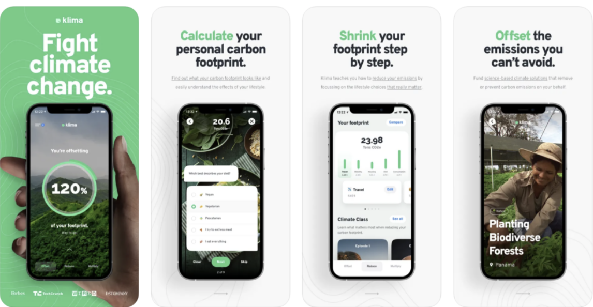
Klima
Easily Measure your carbon footprint

Slide 8
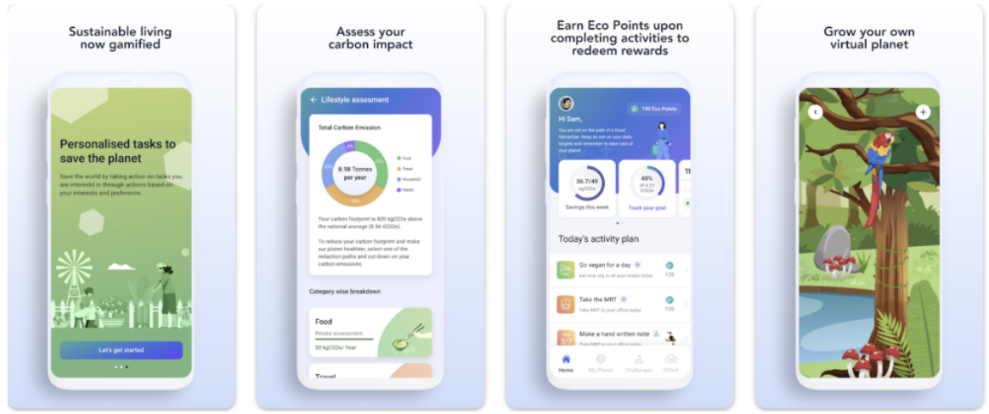
Adva
Make improvements in reducing your carbon footprint with personalized in-app advice on how to live more sustainable

Slide 9
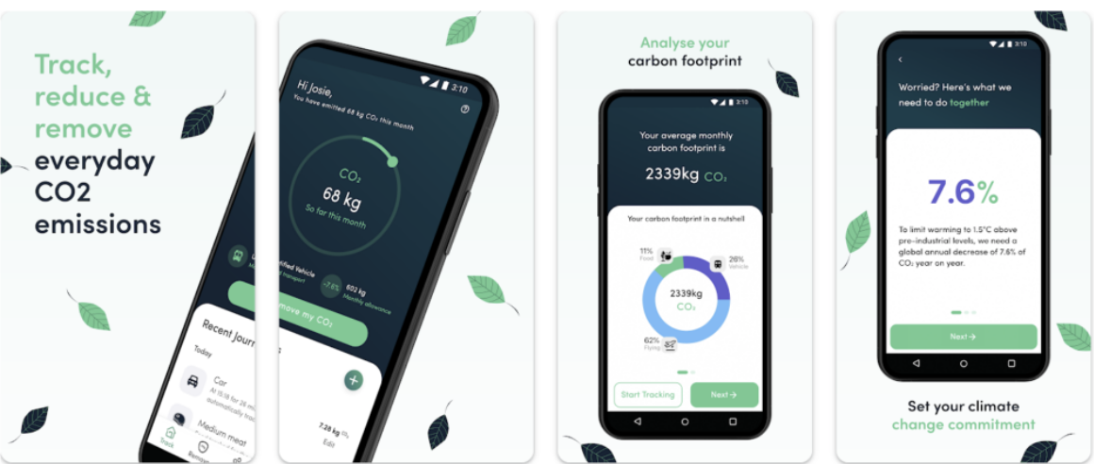
Capture
Reduce your carbon footprint by targeting your top carbon emitters
Add-on feature to encourage ‘green challenges’ across a team

Slide 10
Technology
Figma
Firebase
Android Studio
Github
Used to design high-fidelity prototypes
Database we used to store our users’ information
IDE for the development of Android application
A service we used to remotely collaborate with each other and have access to the update version of the App.

Slide 11
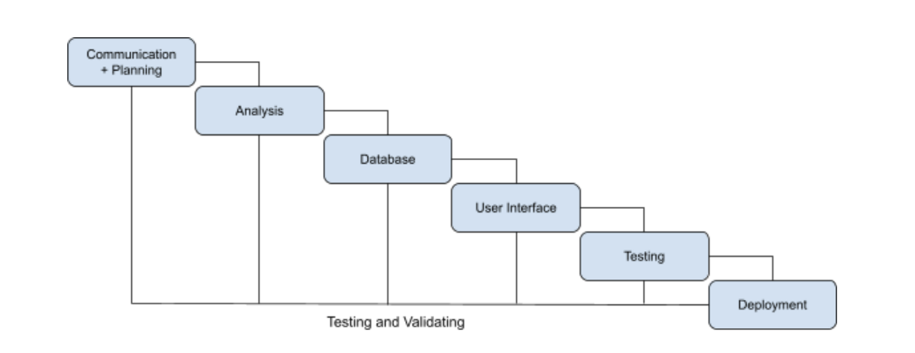
Hybrid of Waterfall and V-Model
Step 1
Step 2
Step 3
Step 4
Research
Prototype
DB design
Code Construction
Step 5
Step 6
Error Testing
Deployment

Slide 12
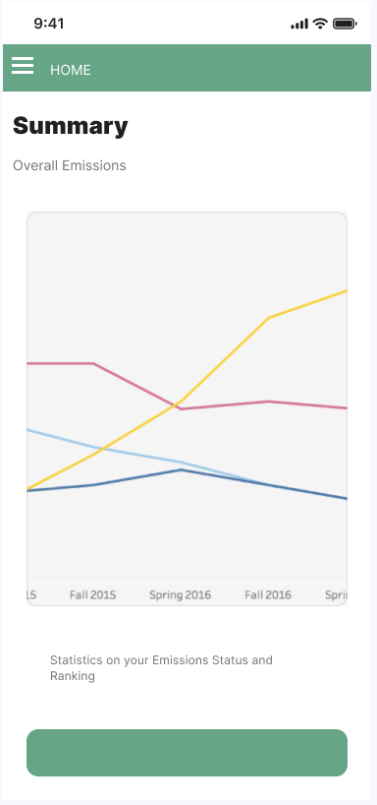
Figma

Slide 13
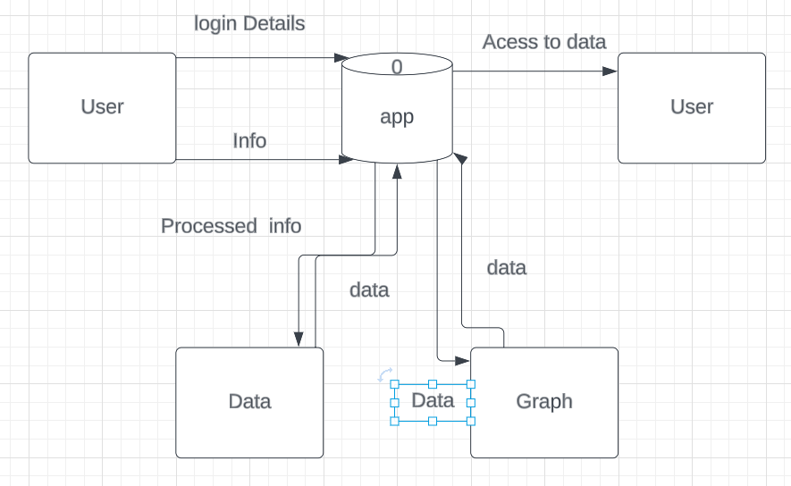
Context Level Diagram

Slide 14
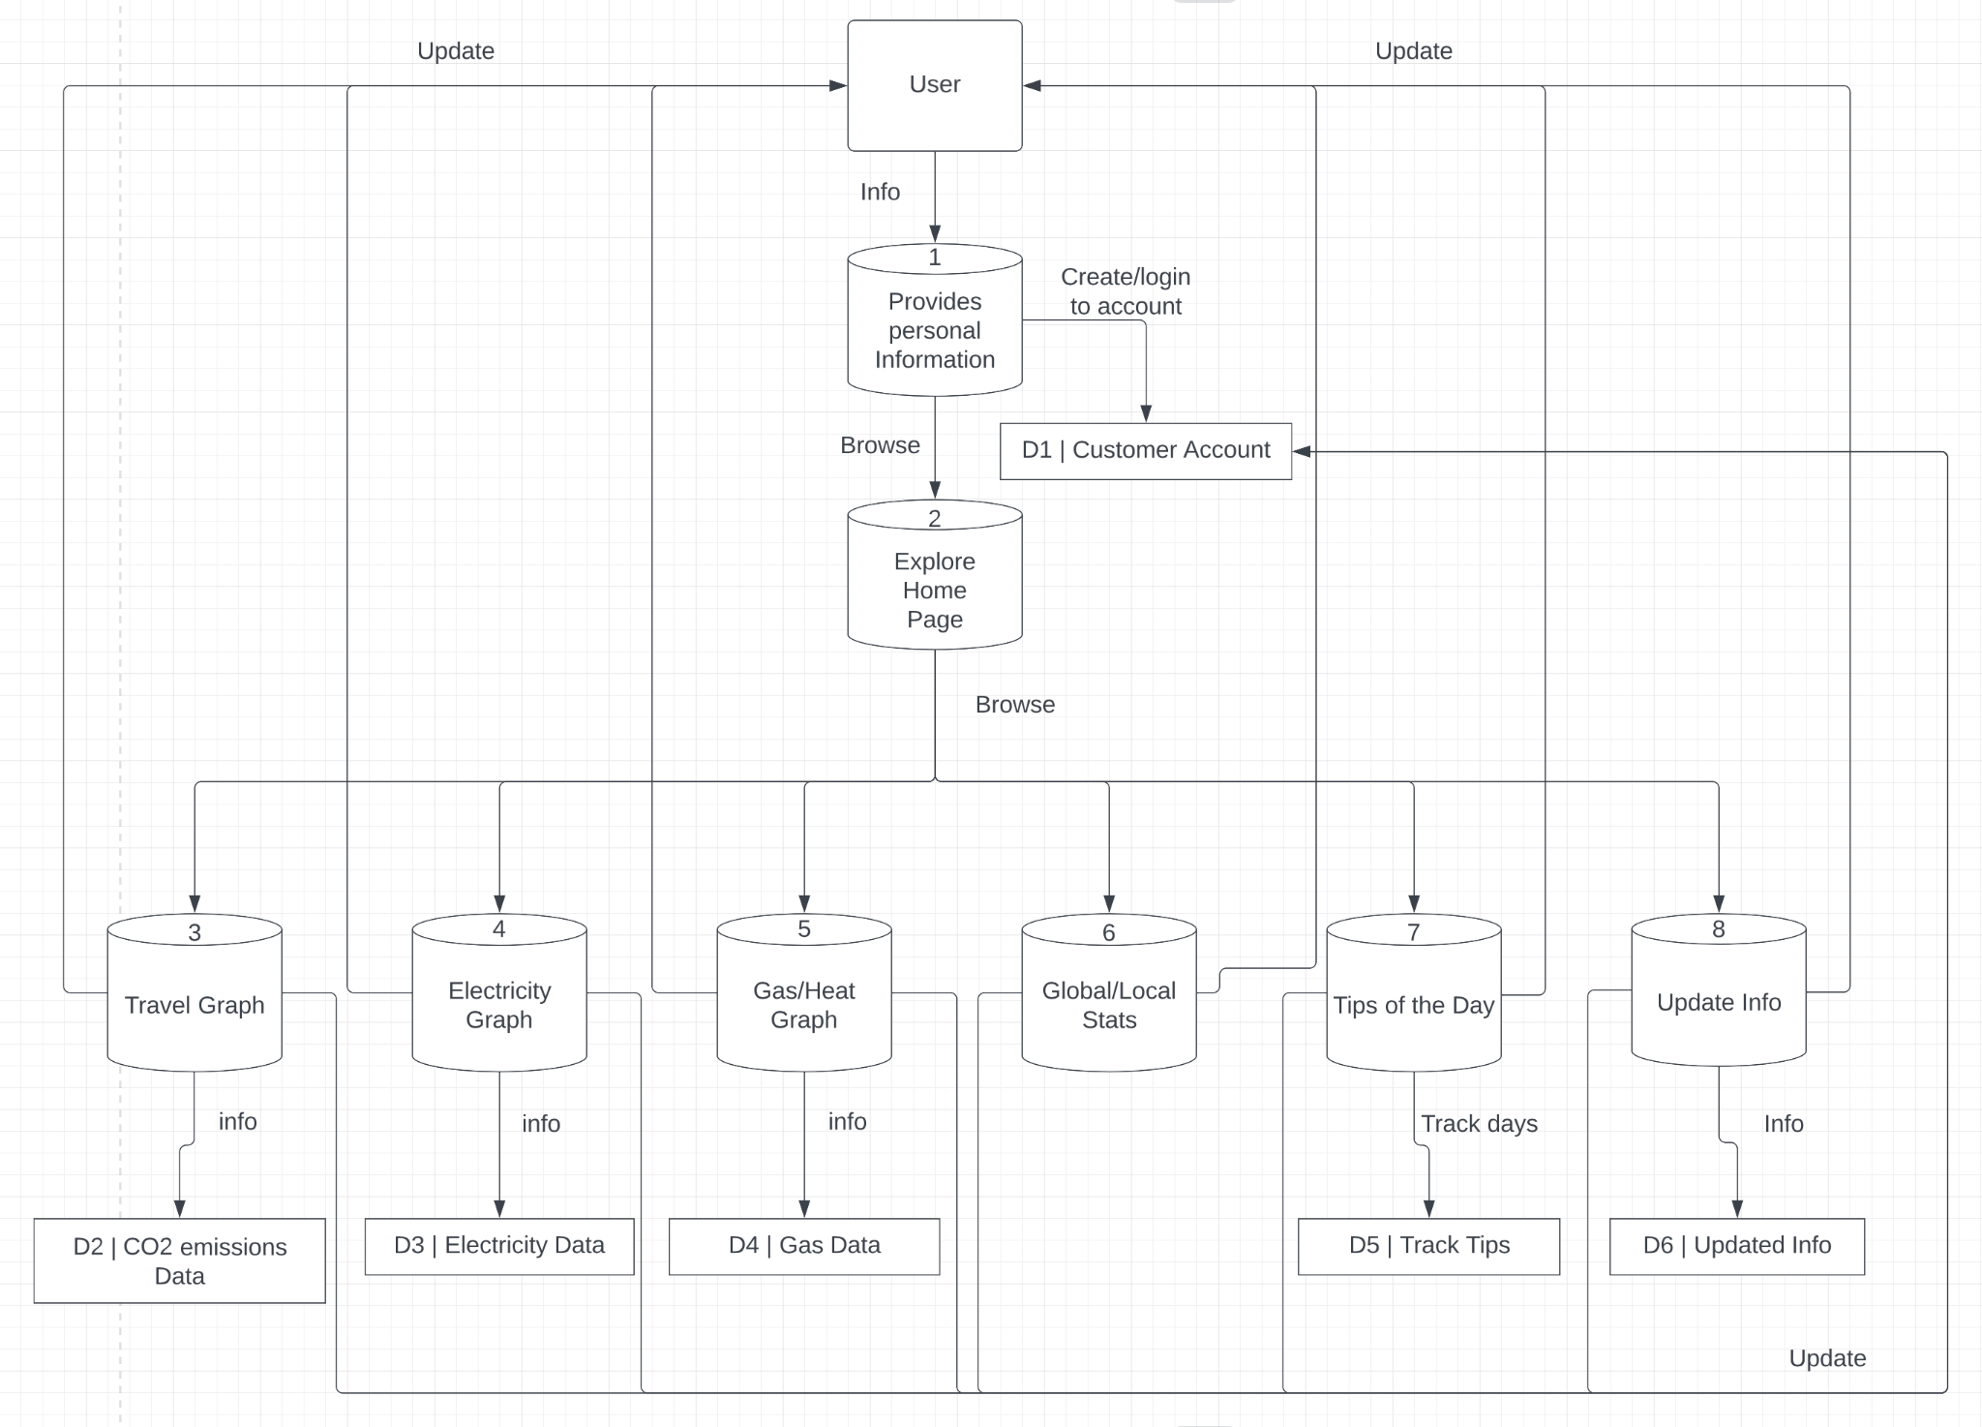
Data Flow Diagram

Slide 15
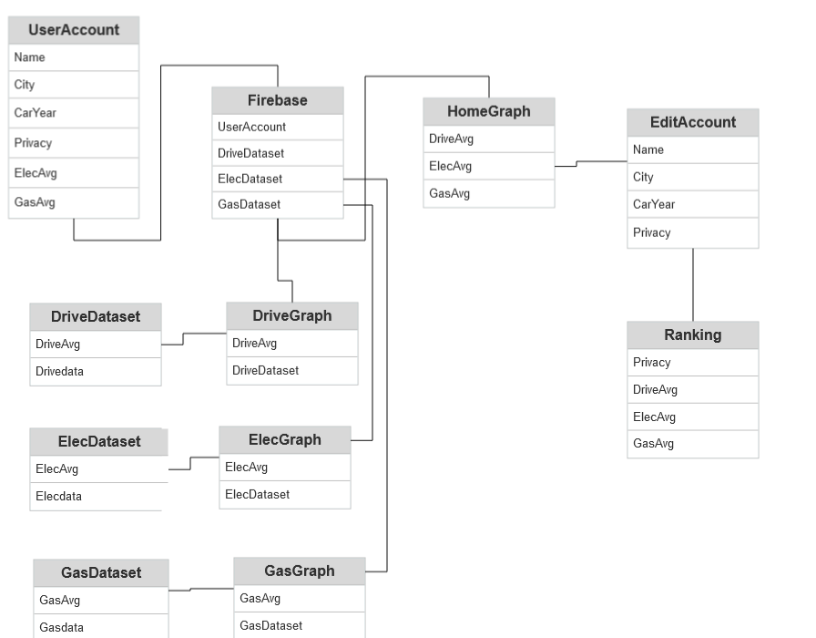
Entity Relationship Diagram
Notes:
Is this right?

Slide 16
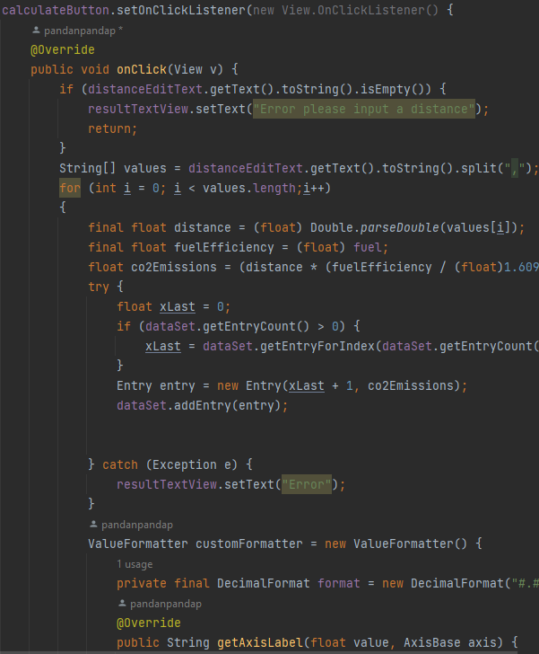
Example of Code
Takes information from the textfiles and runs calculations that are then put into the appropriate dataset and plots it using the dataset

Slide 17
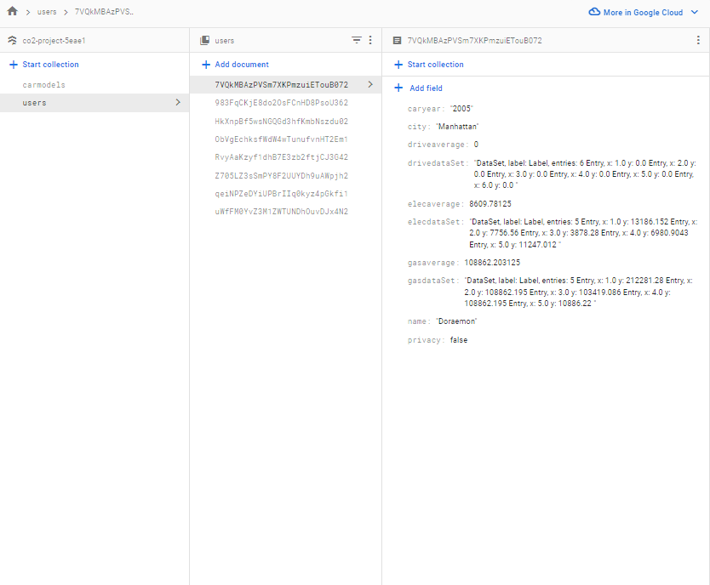
Firebase
Screenshot of the Firebase Console where the FireStore is located

Slide 18
Live Demo

Slide 19
Demo Video
Notes:
In case live demo fails

Slide 20
Testing
System Testing
Unit Testing
Error Testing
Ensuring that all the integrated components are working properly together
Ensuring that each function and method is working as intended
Checks to see if the system is capable of future errors that may occur

Slide 21
Limitations and Challenges
Time
Experience in Android Studios
Limitations of Firebase

Slide 22
Future Plans
Better Front End
More specific data
Better database
To improve the database, the app can integrate with real-time carbon emissions data and provide users with up-to-date information on emissions levels in their area.
More personalization
To offer more personalization, the app can include features such as personalized recommendations, alerts, and rewards based on individual usage patterns.
Add more social options
To add more social options, the app can incorporate social features such as leaderboards, challenges, and social sharing options.

Slide 23
COURSES
Senior Project
CSCI
CSCI 425
ETCS 108
CSCI 185
CSCI 380
CSCI 300

Slide 24
Our Team's Contribution
Angily
Nickolas
Christine
Nelson
Provided the energy consumption reports & statistical data that our application used. Worked on the visual models and wireframe. Frontend
Coded the algorithms for the code, half of the login page, intro animation, made logo, worked all around, backend
Researched similar apps, Worked on the graph portion of the application, Helped work on the edit page. Helped with the Frontend
Edited and Combined everything, Other half of the login page, worked on most aspects of the project, Database, backend

Slide 25
References
https://www.bts.gov/content/estimated-national-average-vehicle-emissions-rates-vehicle-vehicle-type-using-gasoline-and
https://greenzerocarbonhome.com/2018/07/what-is-the-carbon-footprint-of-natural-gas-heating-oil-propane-and-coal/#:~:text=A%20Therm%20is%20100%2C000%20BTUs,million%20BTUs%20used%20by%20120
https://www.eia.gov/tools/faqs/faq.php?id=74&t=11
https://www.fuelsinstitute.org/

Slide 26

Thanks!
Do you have any questions?

